Slide 1
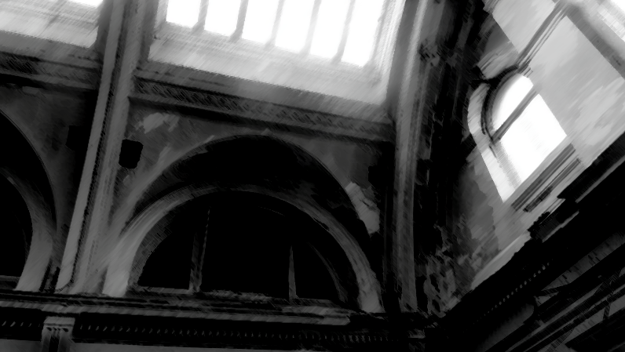

WANT TO ENGAGE MILLENnIALS?
Try Preservation.
Assistant Professor: Jeff Fulton, Allied ASID, IDEC
Professor, Director: Beth R. Miller, PhD, ASID, IDEC, NCIDQ
Presenters:
Jeff Fulton, Allied ASID, IDEC
Lyndsey Miller, ASID, IDEC, NCIDQ

Slide 3


Slide 5
Research methodology
Online Survey conducted among 636 Millennials from February 7-15, 2017
Sample was balanced to be representative of the Millennial generation by GENDER, AGE, and RACE
Survey averaged 10 minutes in length

Slide 6
MILLENNIALS CONNECT WITH THE CAUSE

Slide 7
Nearly all Millennials feel it is important to PRESERVE AND CONSERVE buildings, architecture, neighborhoods, and communities.

Slide 8
Nearly two-thirds who believe this is important but have not been involved in this cause.

Slide 9
More than half of Millennials are interested in getting involved with a group like the National Trust.

Slide 10
More than half of Millennials prefer to SHOP or DINE in unique or historic downtowns vs. chain restaurants or shopping malls. They will do business with those that support historic preservation over those that do not.

Slide 11
MILLENNIALS MIX THE OLD AND THE NEW

Slide 12
There is a slightly stronger preference for living in a new home with modern amenities than in an older home;
but more want to live in an old neighborhood with historic character vs. a new one with modern amenities.
(34% to 41%)
(31% to 44%)

Slide 13
67%
Two-thirds are interested in staying at a historic hotel and
over half would attend a happy hour in a historic building.
58%

Slide 14
56%
Fifty-six would sign a petition to save a historic site or building (local, state, or national)

Slide 15
3 in 5 millennials
Historic travel is appealing to nearly three-in-four millennials.

Slide 16
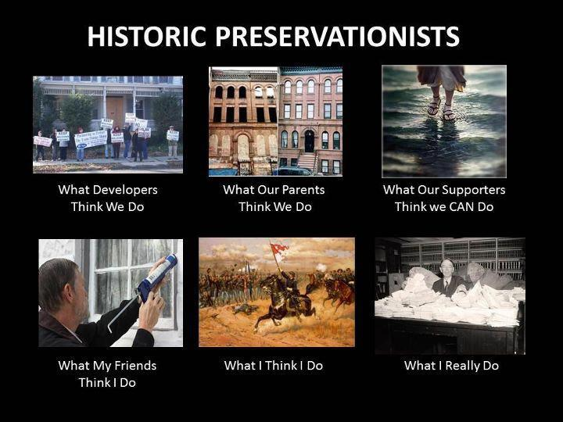

Slide 17
THE COURSE
Special Topics
Introduction to Historic Preservation
offered to Interior Design Millennial Students in Spring 2016

Slide 18
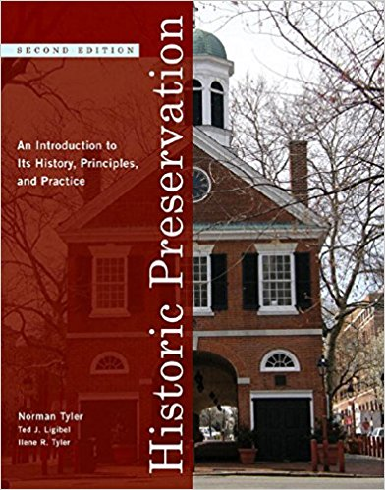
THE COURSE
Survey class follows the text
Historic Preservation; An Introduction to Its History, Principles, and Practice
By Norman Tyler

Slide 19
THE COURSE
The students learn the history of the preservation movement in the
United States
from its beginnings to the present, including
monumental achievements and catastrophic losses.

Slide 20
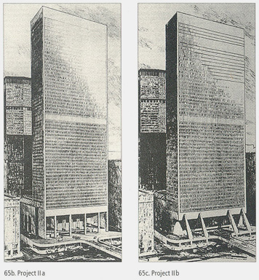

Slide 21
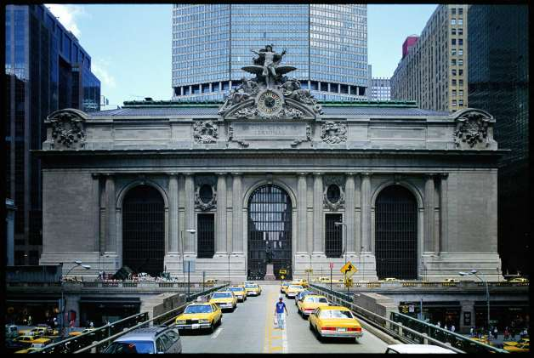

Slide 22
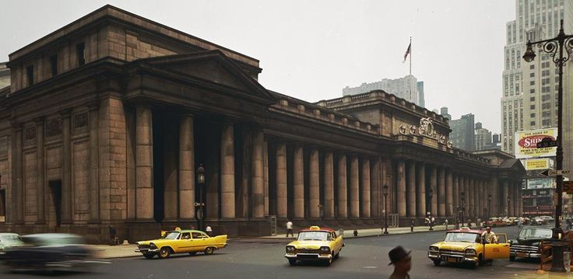

Slide 23
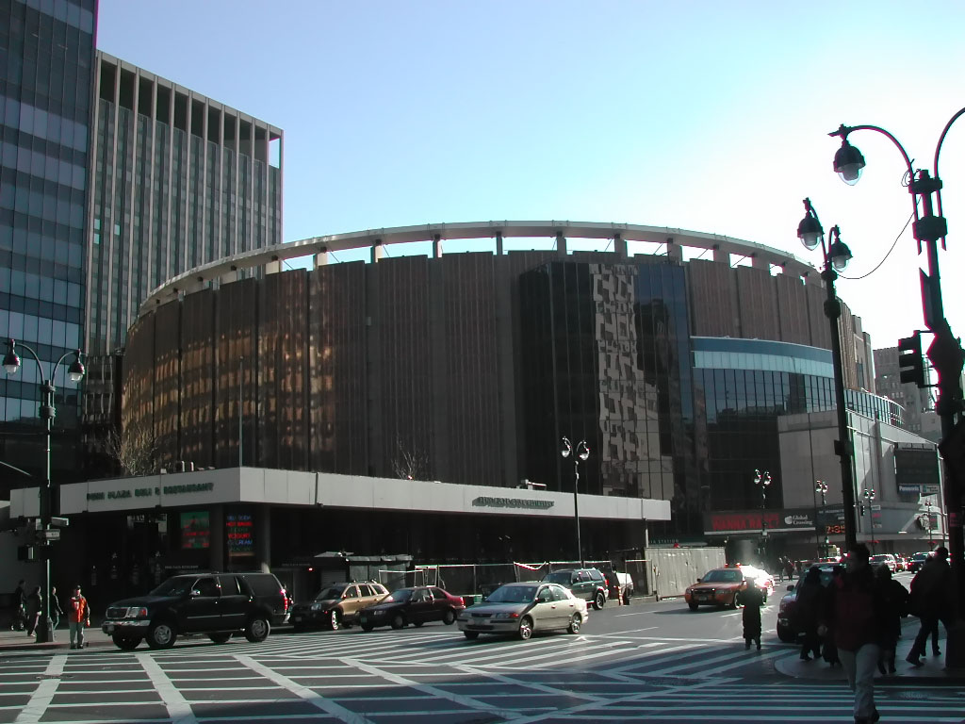

Slide 24
The class project

Slide 25
Project scope
Members from a local church located in a small rural town in Mississippi approached the Interior Design Program about assisting them in protecting their church building.

Slide 26
Project scope
With rural areas facing shrinking populations, shrinking church congregations, and shrinking congregational financial support, many church structures are at risk.

Slide 27
Project scope
The opportunity for community engagement experience for the new course was proposed.

Slide 28
framework

Slide 29
Community engagement
Academic Study
Community
Widely recognized as creating student learning that is DEEPER, LONGER LASTING, and MORE OPEN-MINDED to new situations and circumstances.
SOURCE: Ehrlich, 2007; Zollinger et. al., 2009

Slide 30
Service Learning (Community Engagement) Framework for Interior Design
Criteria | Rationale for Inclusion
Relate to course objectives | Service learning projects contribute to learning objectives for the course. Church members approached Interior Design Program for help documenting their building for Historic Register. Project from church members aligns with community outreach. The time line is more than one semester and will continue in fall 2018. Project embeds knowledge taught in class.
Apply course knowledge | There are no preservationist within the church community. Students use their knowledge of history, design, and technical skills for this project. Students understand that Registration does not protect building. Students apply knowledge of historic architectural details covered in class and other history of design classes.
Connect to the Community | Church members supply written and oral history of building aiding students in developing narratives to satisfy specific forms for registration. Instructor guides students through development of narratives.
Reflect on learning | Success is measured through the appreciation of church members and the knowledge and skills used by students. Students have responded favorably and continue to express interest in on-going process of the church’s nomination.
Source: Zolleringer, Guerin, Hadjiyanni, and Martin, 2009

Slide 31
East facade ©1950 showing front steps that were later removed.

Slide 32
Main objective

Slide 33
It was determined that the most effective assistance would be to register the structure with the National Register of Historic Places in order to recognize the architectural significance of the building.

Slide 34
Although this will not protect the building, it will bring local attention to the structure through national recognition.

Slide 35
process

Slide 36
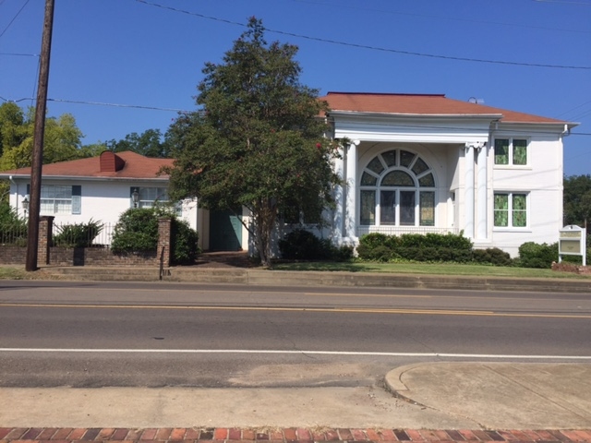
The project began by exposing students to the physical structure of the building, including the history of its lifespan, provided by church members.
Current photograph of exterior facade

Slide 37

Provided examples of previously completed applications as a guideline

Slide 38
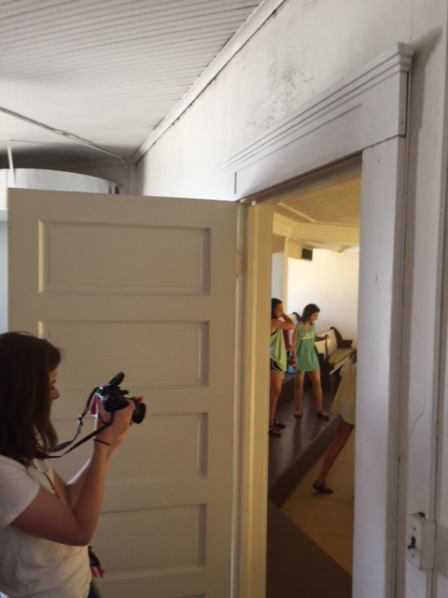
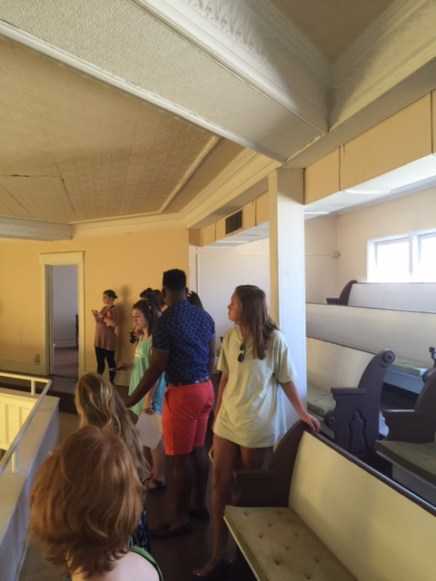
As a group, students visited the structure, took copious notes and photographs of exterior and interior details; they then developed a personal connection with the church.

Slide 39

Data compiled by the students and information was shared with the entire class.

Slide 40


Slide 41
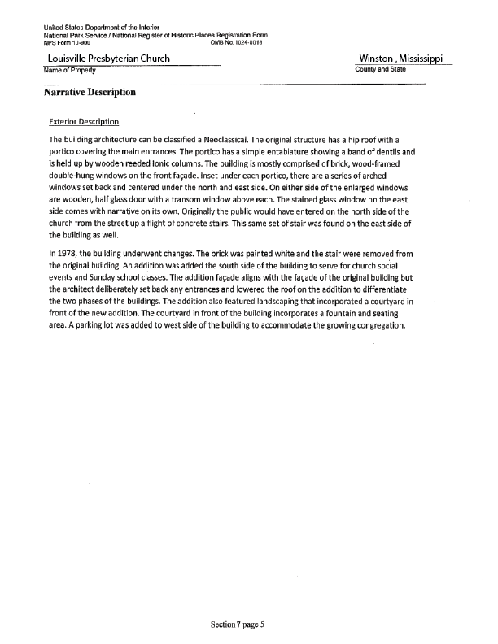
Students developed interior and exterior NARRATIVES, as outlined by the National Register of Historic Places Registration Form.

Slide 42
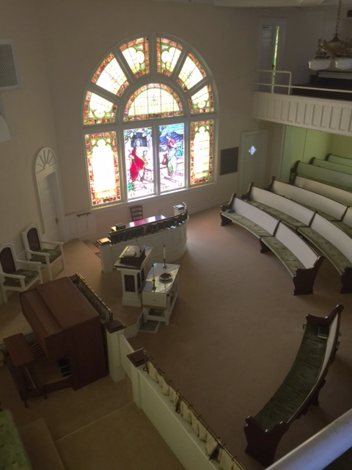
Changes were noted that had been made since its construction, creating a timeline of modifications to the church.
This aided in the effective descriptions that had occurred in the history of the church; was included in the form narratives.

Slide 43
Next steps

Slide 44
Students understood this to be one segment of the nomination process.

Slide 45
This is an ongoing process to be continued in the preservation course to be taught FALL of 2018.
*course has been added to the Interior Design curriculum
Students understood this to be one segment of the nomination process.

Slide 46
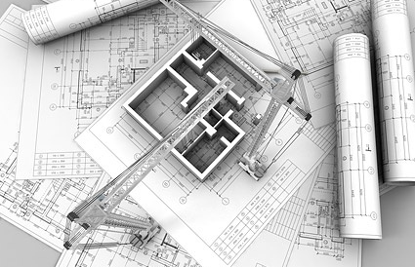
Creating a representational floor plan and site plan using digital drawings.

Slide 47
conclusions

Slide 48
Working with an actual structure and becoming familiar with the documenting process needed to nominate a structure for the National Register, student developed a working knowledge and understanding of preservation by using the tools and techniques taught in class.

Slide 49
Students responded favorably to the community engagement project and continue to be engaged with the church structure and the outcome of its on-going progress toward nomination.

Slide 50
Thank you!
Questions or Comments?
JEFF FULTON………………………… jfulton@caad.msstate.edu
BETH MILLER……………………….. bmiller@caad.msstate.edu

